Slide 1
PSCS_16 – Integration of Analytics into the PGRKAM App
CSE7101- Capstone Project
Review-1
Batch Number: 12
Under the Supervision of,
Mr. Mohamed Shakir
Assistant Professor
School of Computer Science and Engineering
Presidency University
Roll Number | Student Name
20221COM0006​ | MANDAR JOSHI​
20221COM0013​ | REVANTH P​
20221COM0216​ | PREETHAM JAIN DJ​
Name of the Program: BTech
Name of the HoD: Dr.Pallavi R
Name of the Program Project Coordinator: Mr Muthuraju V
Name of the School Project Coordinators: Dr. Sampath A K , Dr. Geetha A

Slide 2
Content
Problem Statement
Objectives
Background and Related work for title Selection
Analysis of Problem Statement
Literature Survey (10+ papers with critical analysis).
Existing Methods & Drawbacks
Feasibility Study (tech, cost, resources)
Architecture Diagram
Innovation or Novel Contributions
Git-hub Link
Timeline of the Project
References

Slide 3
Background and Related Work
Background
The PGRKAM (Pradhan Mantri Kaushal Rozgar Kamal Abhiyaan) web application is designed to connect job seekers with skill training and employment opportunities.
However, it lacks a built-in analytics framework, making it difficult for administrators to track user engagement, adoption of features, and program effectiveness.
Integrating a custom analytics system will allow real-time monitoring, evidence-based decision-making, and better governance.
Related Work
Google Firebase Analytics – widely used for mobile apps, provides event tracking but is vendor-dependent and lacks control over raw data.
Google Analytics (GA4) – useful for websites, but limited in terms of custom event logging for government workflows.
Open-source tools (PostHog, Plausible, Matomo) – offer customizable analytics but are often heavy and require dedicated infrastructure.
Custom Analytics in E-Governance Projects – prior studies show that data-driven insights improve policy design, user adoption tracking, and service optimization.
Gap Identified
Existing solutions are either too generic or not aligned with PGRKAM’s unique needs.
A lightweight, custom-built analytics stack (FastAPI + MongoDB + React Dashboard) ensures data ownership, scalability, and government-focused reporting.

Slide 4
Analysis of Problem Statement
Technology Stack Components:
Backend:
FastAPI – REST API framework for event ingestion
MongoDB – NoSQL database for scalable event storage
Frontend:
React (Vite) – Admin dashboard interface
Recharts – Data visualization (charts & graphs)
Tailwind CSS – Modern, responsive UI styling
Authentication & Security:
JWT – Secure user/session authentication
API Keys – Admin access control
Deployment & Tools:
Docker – Containerization for portability
AWS / Render Cloud – Hosting & scalability
GitHub – Version control & collaboration

Slide 5
Github Link
The Github link provided should have public access permission.
Github Link
https://github.com/Mandarjoshi0408/Capstone_Project

Slide 6
Problem Statement
The PGRKAM app currently has no built-in analytics framework.
Administrators lack visibility into user engagement, adoption, and outcomes.
Generating reports for government programs is time-consuming and manual.
Decisions are based on assumptions instead of data-driven insights.
Impact of the Problem:
Difficult to measure effectiveness of training/employment programs.
No feedback mechanism to improve app features.
Missed opportunity for real-time monitoring and policy evaluation.
Proposed Solution:
Develop a custom analytics system with event tracking, secure APIs, and dashboards.
Provide real-time visualizations of usage metrics.
Enable CSV/Excel export for official reporting.
Ensure data security with JWT & API Key authentication.

Slide 7
Literature Survey ( papers with critical analysis).
Li et al. (2023) – Big data analytics and e-governance: Actors, opportunities, tensions Explores the integration of big data techniques in government, highlighting enhanced decision-making and transparency but addressing infrastructure and adoption challenges.
Schmeling (2025) – Data collaboration in digital government research Investigates the need for interoperable data frameworks across government departments enabling actionable analytics and policy formulation.sciencedirect
Nguyen et al. (2024) – Unlocking e-government adoption Uses TAM to study technology acceptance in government analytics adopting agencies; focuses on trust, usability, and organizational barriers.sciencedirect
Gupta et al. (2024) – AI-Powered Governments: Role of Data Analytics and Visualization Reports accelerating digital transformations with AI and data analytics, emphasizing visualization’s role in public accountability.rsisinternational
Wang et al. (2023) – Application of Text Analytics in Public Service Co-Creation Demonstrates how text and data analytics enable richer citizen engagement in government service improvement.acm
OECD (2024) – E-Government Survey Reviews global analytics adoption maturity, accentuating best practices from digitally advanced governments.desapublications.un
Preet & Sharma (2017) – Role of Big Data Analytics in e-Governance Projects Provides a comprehensive review of big data’s role in improving government services, challenges in adoption, and infrastructural needs.gjimt
LinkedIn Industry Review (2024) – Implementing Big Data Analytics in Government Highlights practical insights into integrating analytics within government workflows focusing on governance, security, and scalability.linkedin
Fielding & Taylor (2002) – Principled design of the modern Web architecture Foundational paper on RESTful web services forming the backbone for scalable analytics platforms used by modern government applications.CSE7101-Capstone-Project-Review1-TEMPLATE-3.pptx

Slide 8
Existing Methods & Drawbacks
Common Analytics Solutions in Government Apps: Google Analytics & Firebase Analytics
Strengths: Easy to integrate, comprehensive user event tracking, and rich reporting. Widely used for mobile and web apps.
Drawbacks: Data stored on vendor servers, raising privacy and data sovereignty concerns for sensitive government data. Limited control over raw data and customization for unique government workflows.
Open-source Analytics Platforms (e.g., PostHog, Matomo, Plausible)
Strengths: Offer data ownership with on-premises deployment, deep customizable event tracking, and compliance flexibility. Suitable for governments seeking data control.
Drawbacks: Require dedicated infrastructure and skilled personnel to deploy, maintain, and scale. Sometimes heavier resource consumption and complex setups than managed services.
Custom-Built Analytics Solutions
Strengths: Tailored to specific government needs, full ownership of data, flexible architectures (e.g., FastAPI, MongoDB, React stack). Enhanced privacy and security management.
Drawbacks: Higher initial development effort and requiring ongoing maintenance. Dependency on in-house or contracted developer expertise. Potential risks around scalability without adequate planning.

Slide 9
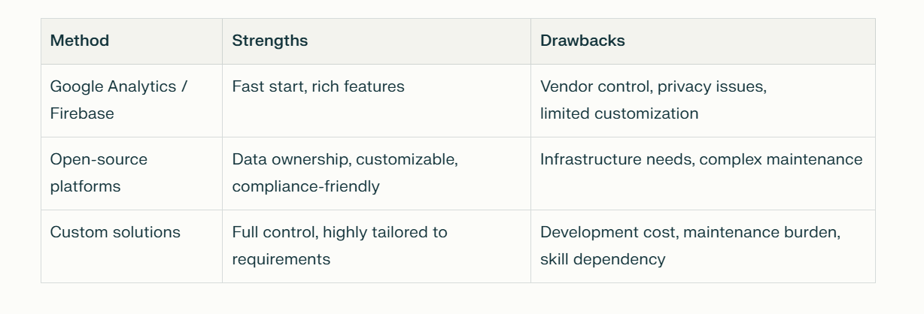
Existing Methods & Drawbacks

Slide 10
Feasibility Study (tech, cost, resources)
Technology Feasibility:
Backend: FastAPI (Python) - scalable REST APIs
Database: MongoDB NoSQL - flexible, scalable storage
Frontend: React with Vite + Recharts - responsive dashboards
Security: JWT for authentication, API Keys for access control
Deployment: Docker containers on AWS / Render Cloud
Cost Feasibility:
Open-source tech stack - no licensing fees
Estimated cloud hosting: ₹1,000 - ₹5,000/month (scale-dependent)
Storage and backup scalable with usage
Development & maintenance: Initial team (2-3 devs), ongoing 10-20% yearly cost

Slide 11
Feasibility Study (tech, cost, resources)
Resource Feasibility:
Team: 2 Backend developers, 1 Frontend developer, 1 Project manager/admin
Timeline: Prototype in 3 months, Full deployment in 6 months
Risks and mitigations: Skill gaps managed via training; cloud cost optimized by monitoring
Summary:
Solution is technically feasible, cost-effective, and resource-efficient.
Aligns well with government requirements for data sovereignty, security, and customization.

Slide 12
Proposed Methodology
Requirement Analysis
Understand the existing PGRKAM app workflows and identify gaps in monitoring.
Define key metrics to be tracked: user logins, job applications, training enrollments, feature usage.
Finalize technology choices (FastAPI, MongoDB, React/Vite, Recharts).
System Design
Architecture:
Client (PGRKAM App SDKs) → FastAPI Backend → MongoDB Database → React Admin Dashboard.
Database schema:
users (admin credentials).
events (user actions, metadata, timestamp).
reports (generated summaries, CSV exports).
Backend Development (FastAPI + MongoDB)
Implement event ingestion APIs for logging user activity.
Provide secure endpoints for admin dashboards (/events, /stats).
Add CSV/Excel export APIs for reporting needs.
Frontend Dashboard (React + Vite + Recharts)
Build an interactive dashboard for administrators.
Integrate charts & graphs for real-time analytics.
Provide filters (date, event type) and export options.
SDK/Client Integration
Develop lightweight SDKs/snippets (Web & Android) for sending events from the PGRKAM app.
Ensure compatibility with existing app features.
Testing & Validation
Containerize services using Docker.
Deploy on cloud (AWS/Render) with scaling support.
Monitor logs and performance metrics.
8. Documentation & Handover
Prepare README & API docs for developers.
Provide admin training on using the dashboard.

Slide 13
Complete Workflow
User Interaction (PGRKAM App)
Job seekers perform actions such as login, job application, course enrollment, etc.
Embedded SDK automatically triggers event logs.
Event Tracking Layer
Lightweight Web/Android SDK sends event payloads.
Events include: user_id, event_type, timestamp, and device metadata.
Backend Event Ingestion (FastAPI)
Receives event POST requests from client apps.
Validates events using JWT/API Key authentication.
Stores structured events into MongoDB collections.
Event Storage & Processing (MongoDB)
Raw events are stored in scalable NoSQL collections.
Aggregations generate summary statistics for dashboards.

Slide 14
Complete Workflow
Admin Dashboard (React + Recharts)
Real-time visualizations of user engagement & feature adoption.
Filters by date, user type, and event type.
Export reports in CSV/Excel format.
Reporting & Governance
Admins use analytics insights for:
Monitoring program effectiveness.
Identifying less-used features.
Improving training and employment workflows.

Slide 15
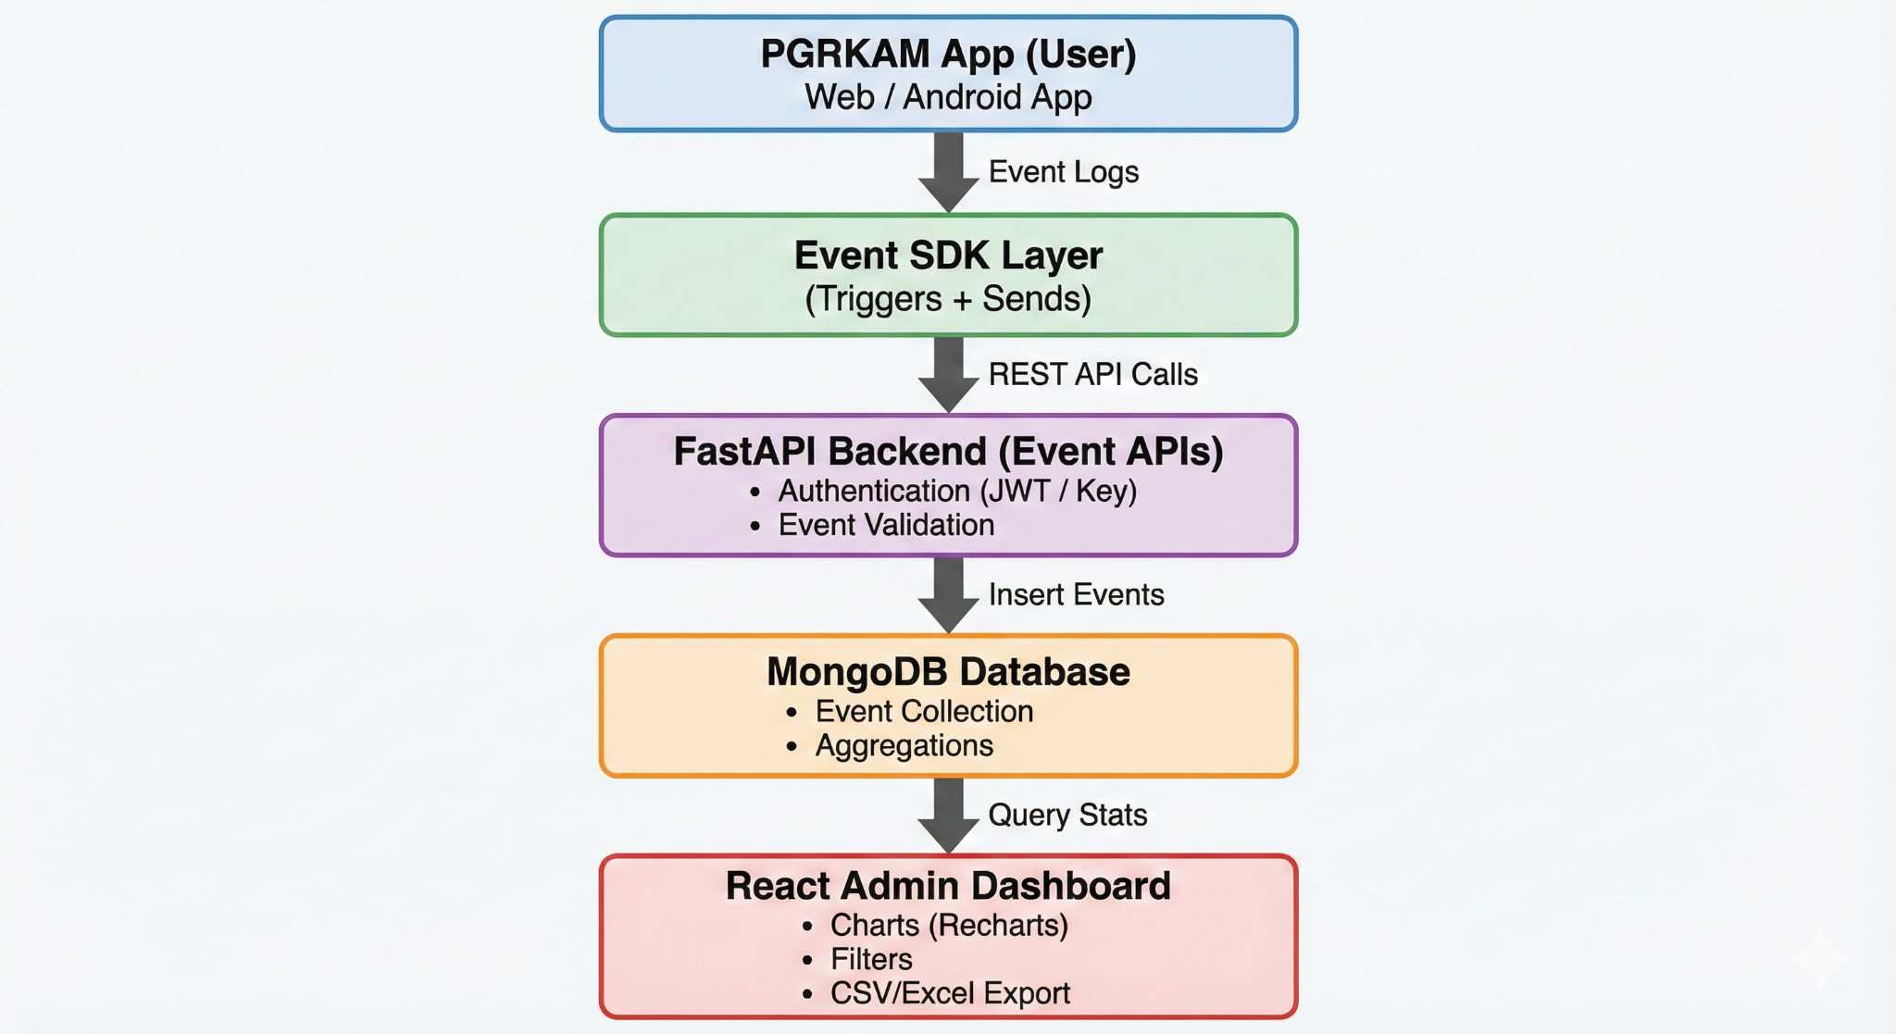
. Block Diagram

Slide 16
Proposed Architecture
Frontend Layer
PGRKAM App (Web/Android) integrated with event-logging SDK.
Admin Dashboard (React + Vite) for visual analytics & reporting.
Backend Layer
FastAPI REST APIs for:
Event ingestion
Dashboard data retrieval
Authentication & authorization
Report export services

Slide 17
Proposed Architecture
Database Layer
MongoDB NoSQL database for storing:
Raw event logs
Aggregated datasets
Admin user credentials
Security Layer
JWT for authenticating dashboard access.
API Keys for protected ingestion endpoints.
Role-based access for government admins.
Deployment
Dockerized microservices for portability.
Hosted on AWS/Render Cloud with auto-scaling support.

Slide 18
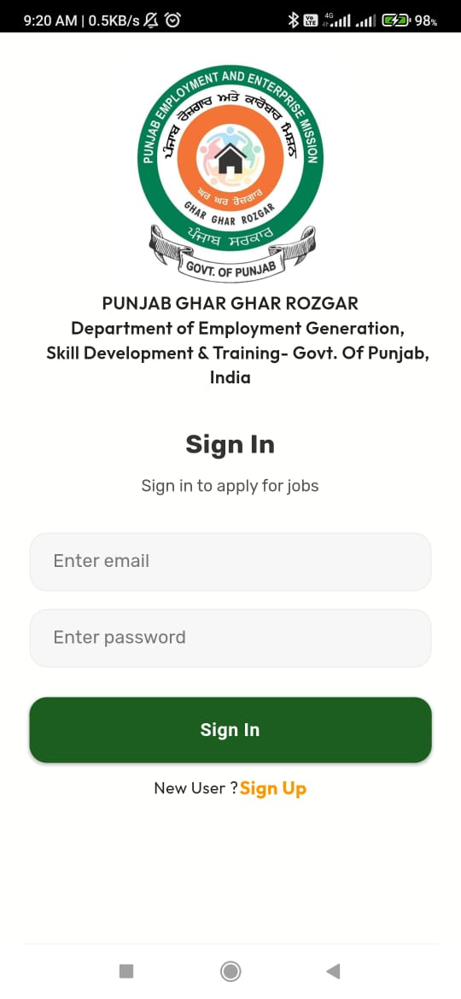
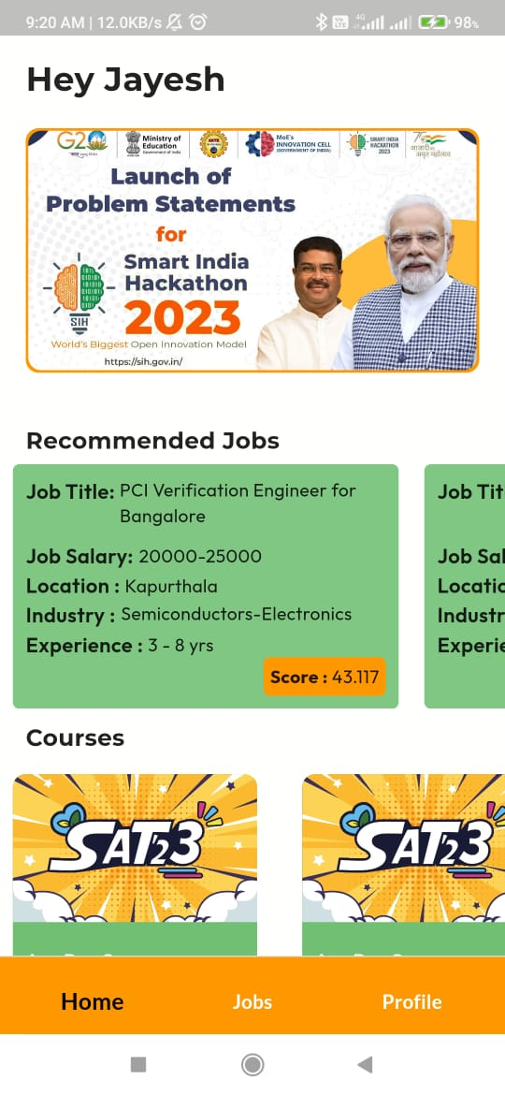
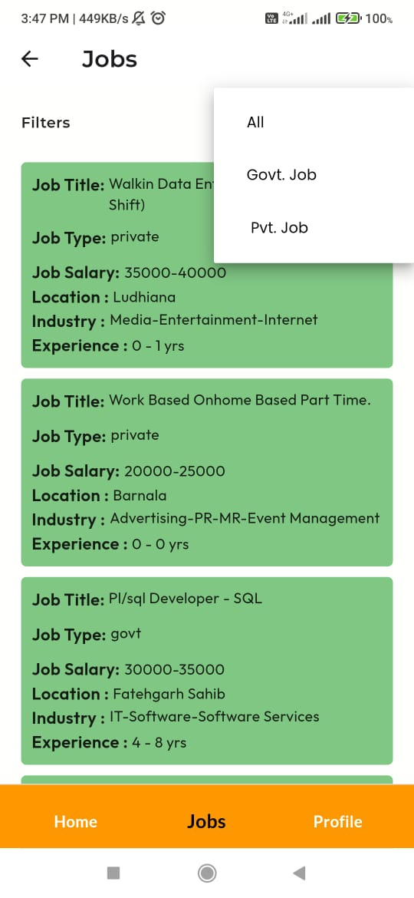
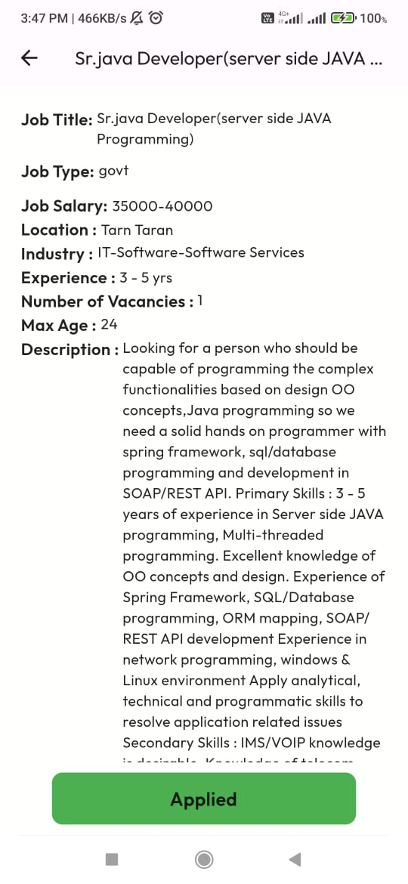
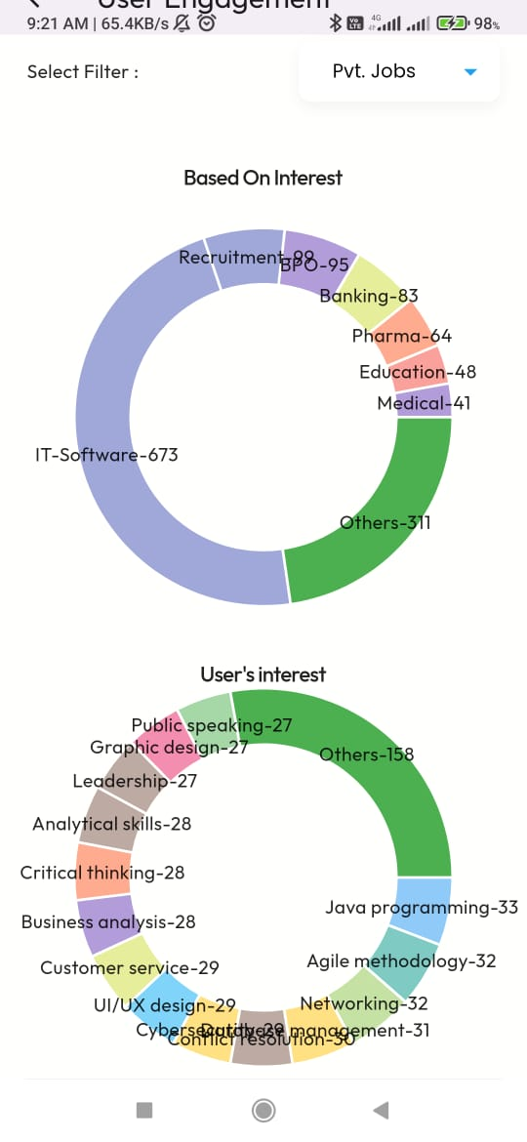
Results

Slide 19
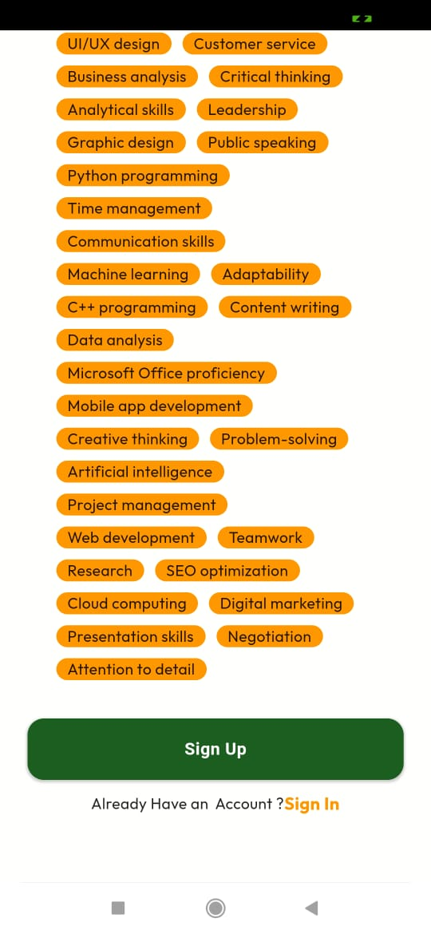
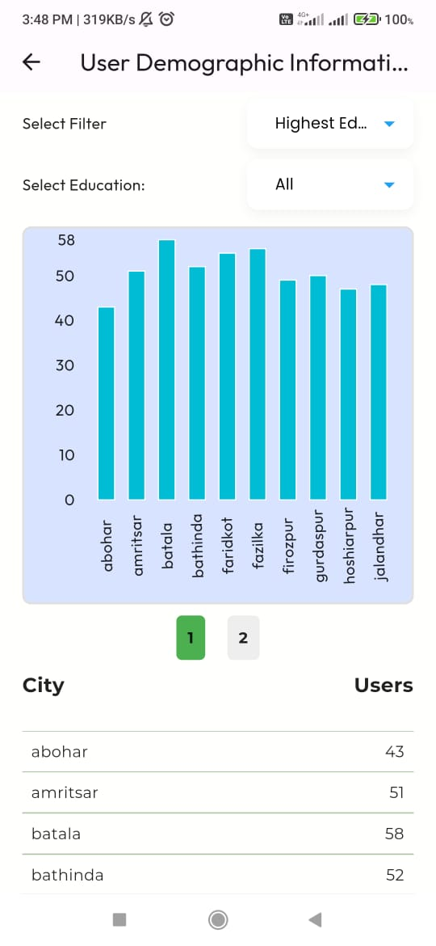
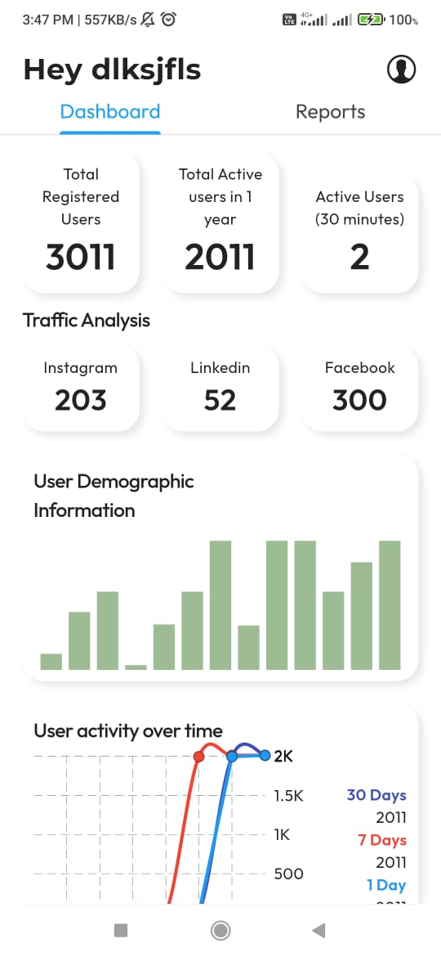
Results

Slide 20
Innovation / Novel Contributions
Custom Analytics Stack – purpose-built for PGRKAM instead of relying on generic tools like Firebase/Google Analytics.
Data Ownership & Privacy – all event data stored in MongoDB, ensuring government control over sensitive user information.
Lightweight SDKs – simple Web & Android snippets to track events without performance overhead.
Interactive Dashboard – built with React (Vite) + Recharts, providing real-time visualizations tailored for government administrators.
Secure Access – admin-only dashboards protected via JWT & API Keys.
Export & Reporting – one-click CSV/Excel downloads to support official reports & audits.
Scalable & Modular – containerized with Docker, ready for cloud deployment (AWS/Render).

Slide 21
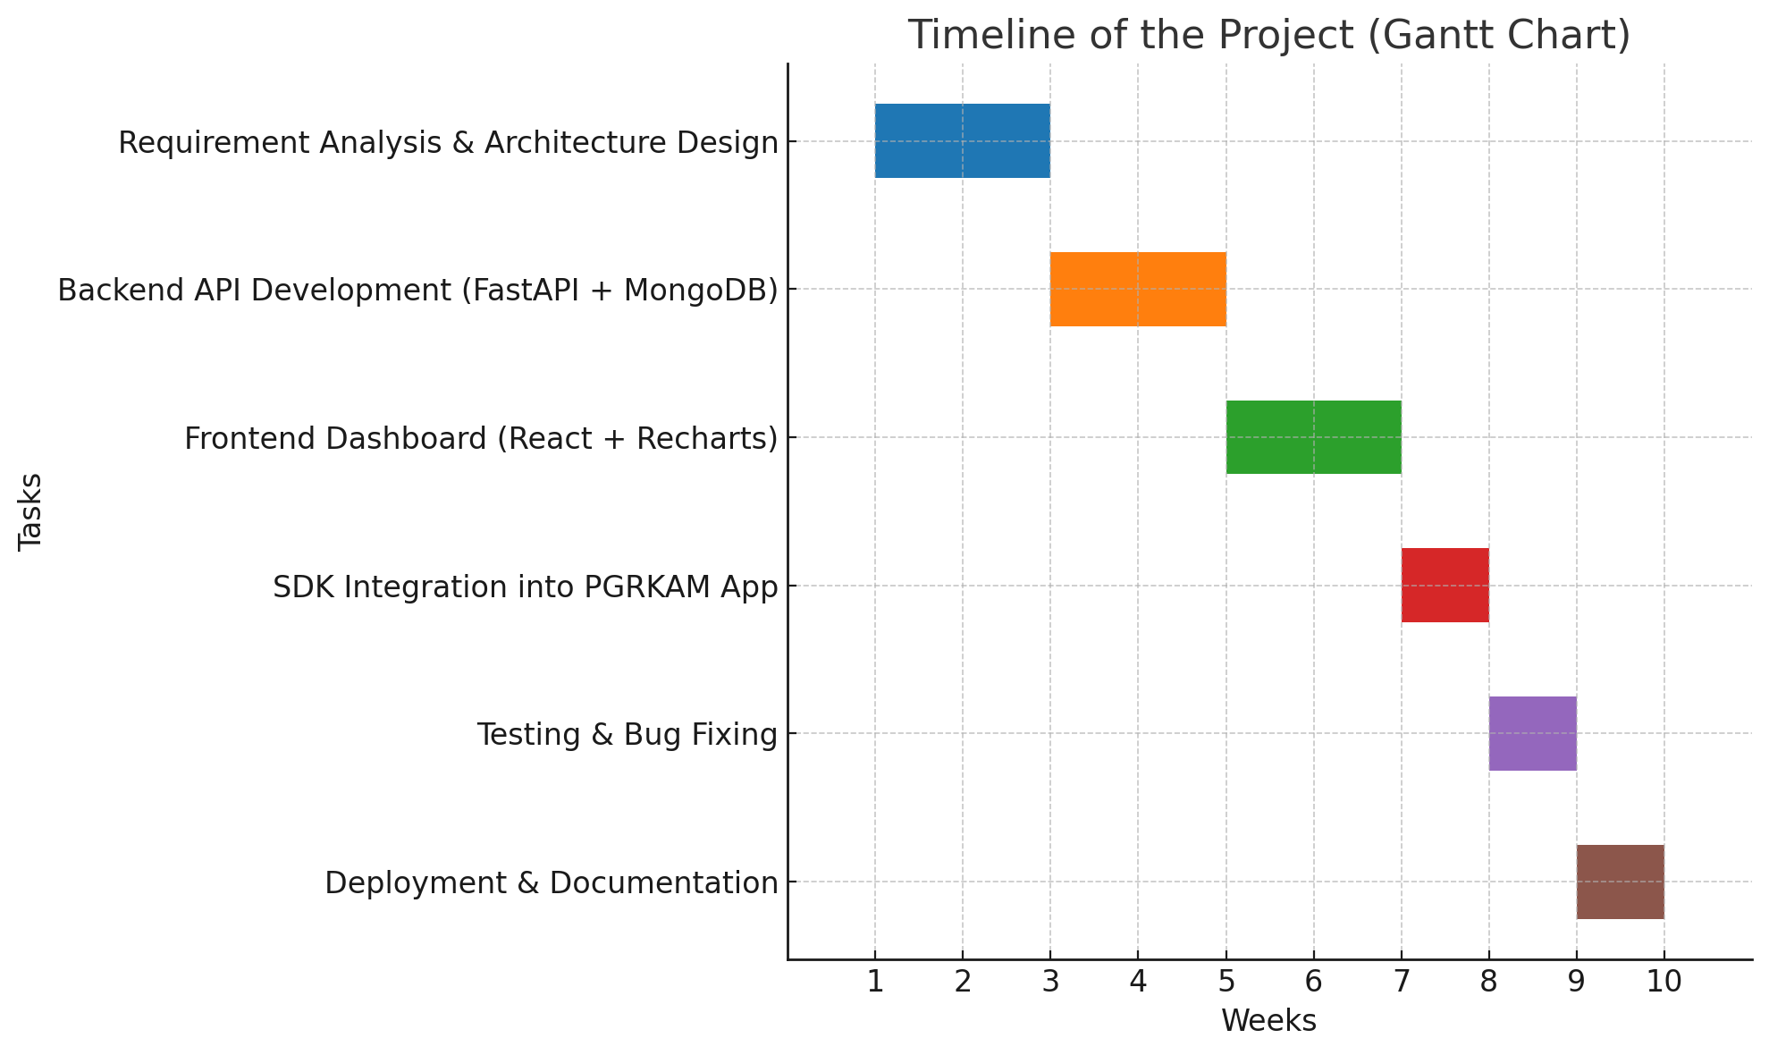
Timeline of the Project (Gantt Chart)

Slide 22
References (IEEE Paper format)
[1] Li, Y., Wang, X., "Big data analytics and e-governance: Actors, opportunities, tensions," Technological Forecasting and Social Change, vol. 191, Jul. 2023. Link: https://www.sciencedirect.com/science/article/abs/pii/S0040162523002974
[2] Schmeling, M., "Data collaboration in digital government research," Government Information Quarterly, vol. 42, no.1, Jan. 2025. Link: https://www.sciencedirect.com/science/article/pii/S0740624X25000577
[3] Nguyen, T., et al., "Unlocking e-government adoption: Exploring the role of analytics," Government Information Quarterly, 2024. Link: https://www.sciencedirect.com/science/article/pii/S2199853124000854
[4] Gupta, A., et al., "AI-Powered Governments: The Role of Data Analytics and Visualization in Accelerating Digital Transformation," 2024. Link: https://rsisinternational.org/journals/ijriss/articles/ai-powered-governments-the-role-of-data-analytics-and-visualization-in-accelerating-digital-transformation/
[5] Wang, P., et al., "Application of Text Analytics in Public Service Co-Creation," Proceedings of ACM Digital Government Research Conference, 2023. Link: https://dl.acm.org/doi/10.1145/3598469.3598471
[6] OECD, "E-Government Survey 2024," 2024. Link: https://desapublications.un.org/sites/default/files/publications/2024-09/(Web%20version)%20E-Government%20Survey%202024%201392024.pdf
[7] United Nations, "UN E-Government Survey 2025," 2025. Link: https://www.oecd.org/en/topics/policy-issues/digital-government.html
[8] Preet, M., Sharma, N., "Role of Big Data Analytics in Analyzing e-Governance Projects," GJIMT, 2017. Link: https://www.gjimt.ac.in/wp-content/uploads/2017/10/Preet-Navdeep_Manish_Neeraj-Sharma_Role-of-Big-Data-Analytics-in-Analyzing-e-Governance-Projects.pdf
[9] LinkedIn Industry Insights, "Implementing Big Data Analytics in the Government Industry," 2024. Link: https://www.linkedin.com/pulse/implementing-big-data-analytics-government-industry-detailed-jm43e

Slide 23


